Slide 1
STRUCTURED PROGRAMMING CONCEPTS Part 1 - Test1 Portion (CO1 and CO2)
Essence of Structured Programming Concepts
Header Files and Library files
The Characteristics, Pros, Cons and Applications of C Programming Language
Syntax and Program structure
Data Types
Operators and Expressions
Statements
Input and Output functions in C
Arrays and Strings
Functions and modular Programming
PDLC and IDE
Programming Languages Paradigm
Properties of Good Programming Languages
Reasons for Popular Programming Languages

Slide 2
Structured Programming Concepts Agenda – Date 27.10.22
Review of Previous Class
Expressions
Short- Circuit evaluation
L Values and R values
Types of Expressions
Type Checking and Conversion in Expression Evaluation
Implicit Conversation
Explicit Conversion
Discussion Topics -Statements and Sequence Control
Introduction statements
Types of statements
Sequential statements
Iterative Statements
Control Transfer Statements
Expression Statements – IO function Calls
3. Next Class C Syntax (Expressions, Statements)

Slide 3
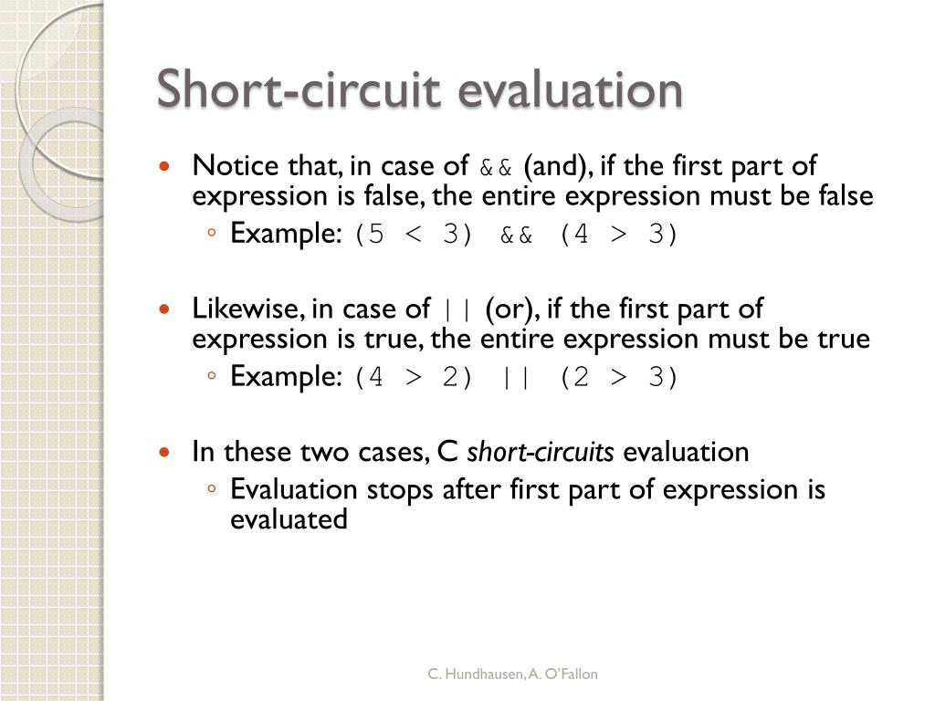
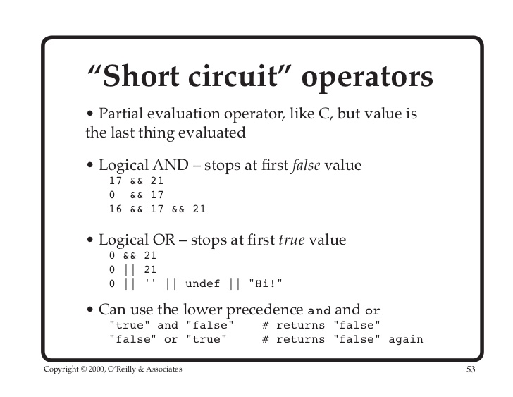

Slide 4
Let flour =3 and sugar is 1. The whole expression will be false, because && combines two falses into false.
flour >= 4 && sugar >= 2
--------- --------
false && false
---------------
false
In fact, as soon as the first false is detected, you know that the entire expression must be false, because false AND anything is false.
flour >= 4 && sugar >= 2 --------- ------------ false && does not matter --------------- false
In fact, as soon as the first true is detected, you know that the entire expression must be true, because true OR anything is true.
flour >= 4 || sugar >= 2 --------- ------------ true || does not matter --------------- true

Slide 5
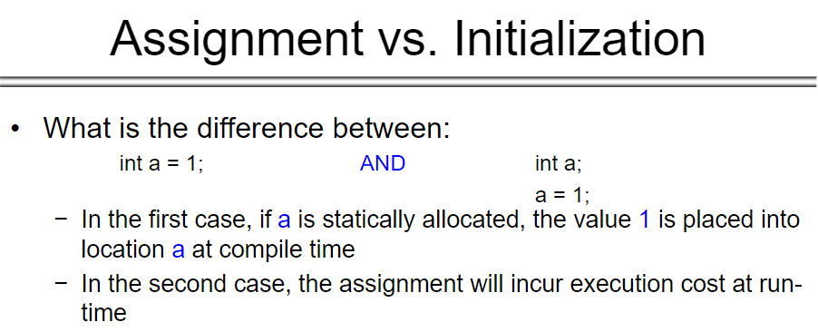
Initialization Only Once in life time
Assignment done many in life time of a variable

Slide 6
assignment_expr ::= lvalue "=" (lvalue | rvalue) ;
lvalue ::= var | dereference | array_lookup | ... ;
rvalue ::= function_call | constant | ... ;
L-value: “l-values are“left values” which refers to memory location which identifies an object. l-value may appear as either left hand or right hand side of an assignment operator(=). l-value often represents as identifier.
The l-value is one of the following:
The name of the variable of any type i.e, an identifier of integral, floating, pointer, structure, or union type.
A subscript ([ ]) expression that does not evaluate to an array.
A unary-indirection (*) expression that does not refer to an array
An l-value expression in parentheses.
A const object (a nonmodifiable l-value).
The result of indirection through a pointer, provided that it isn’t a function pointer.
The result of member access through pointer(-> or .)

Slide 7
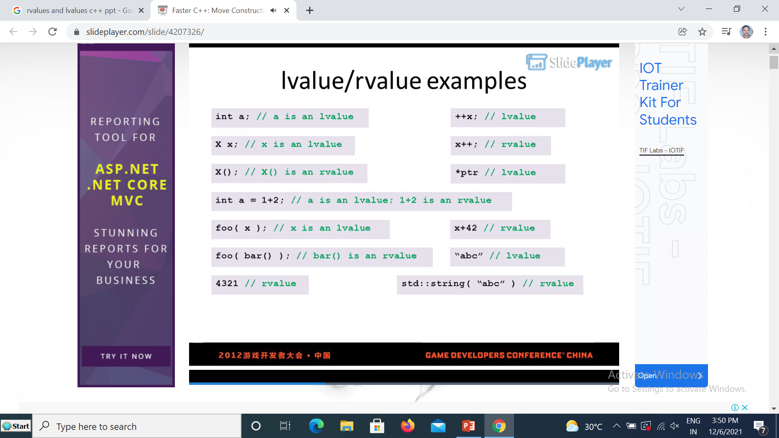
R-value: r-value” refers to data value that is stored at some address in memory. A r-value is an expression that can’t have a value assigned to it which means r-value can appear on right but not on left hand side of an assignment operator(=).

Slide 8
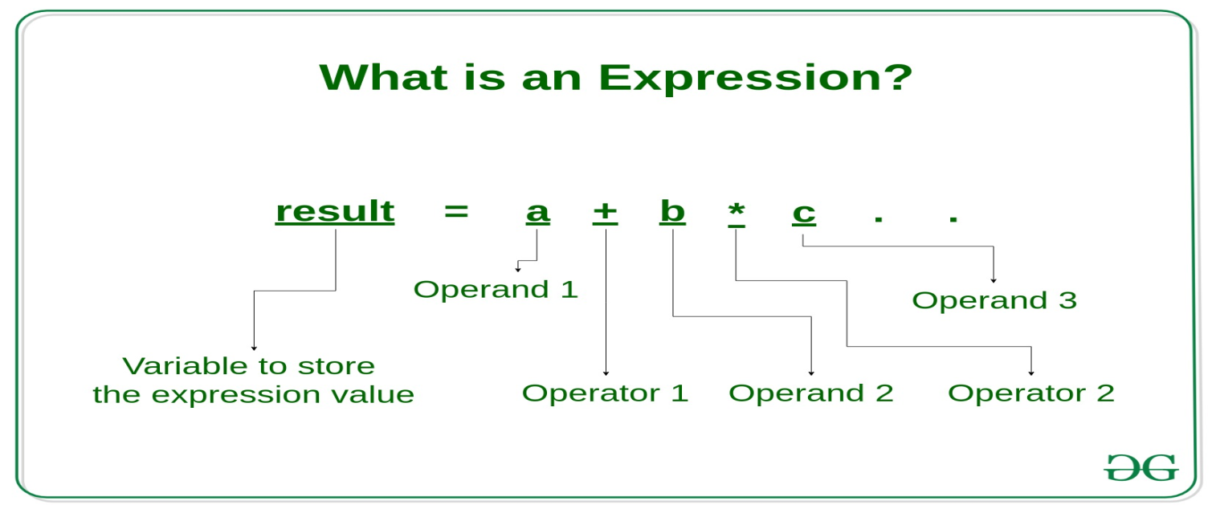
What is an Expression?
Expression: An expression is a combination of operators, constants and variables. An expression may consist of one or more operands, and zero or more operators to produce a value.

Slide 9
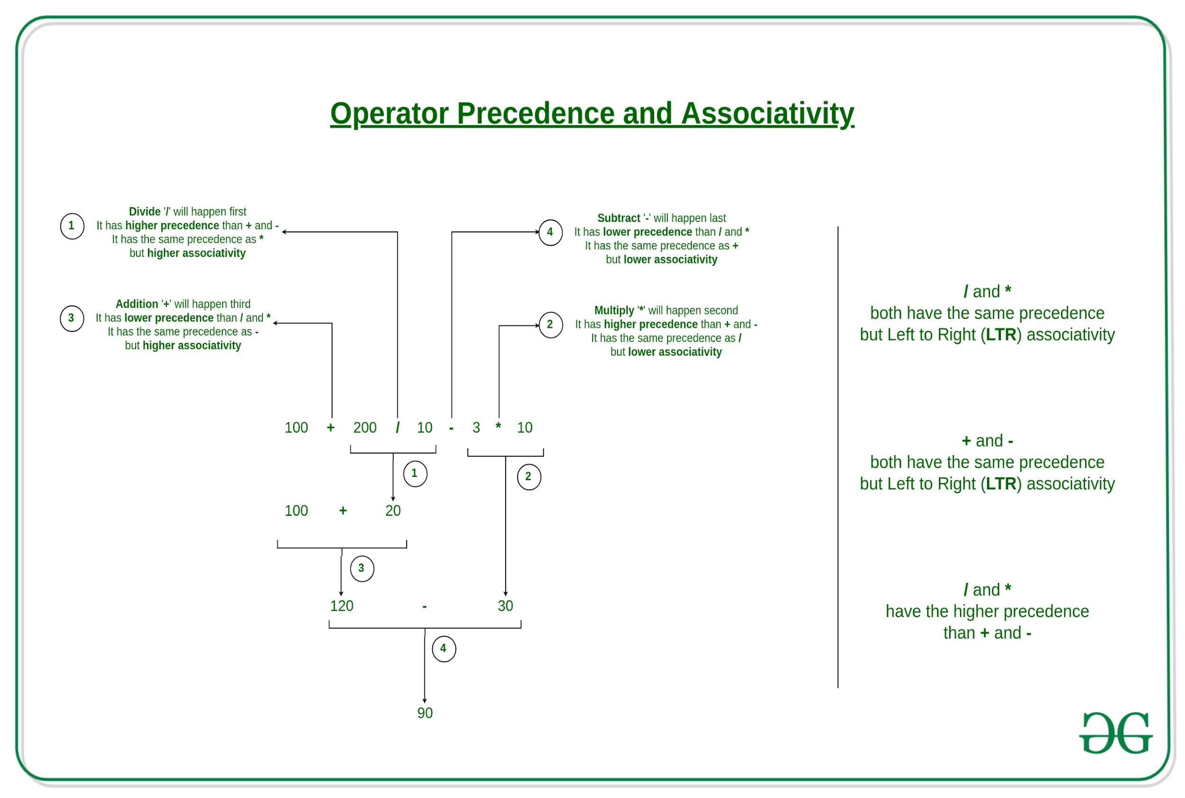

Slide 10
Operator Precedence & Associativity
The arithmetic expressions evaluation are carried out based on the precedence and associativity.
The evaluation are carried in two phases.
First Phase: High Priority operators are evaluated.
Second Phase: Same Priority operators are evaluated based on associativity.
The Sequence Point precedes both phases of evaluation
E.g.1. The Logical Operators ( && and ||) and Short circuit evaluation
E.g. 2 The Conditional Operator(?:) and Mutual exclusive execution.

Slide 11


Slide 12
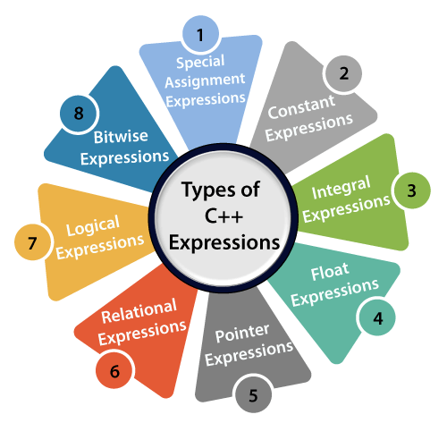

Slide 13
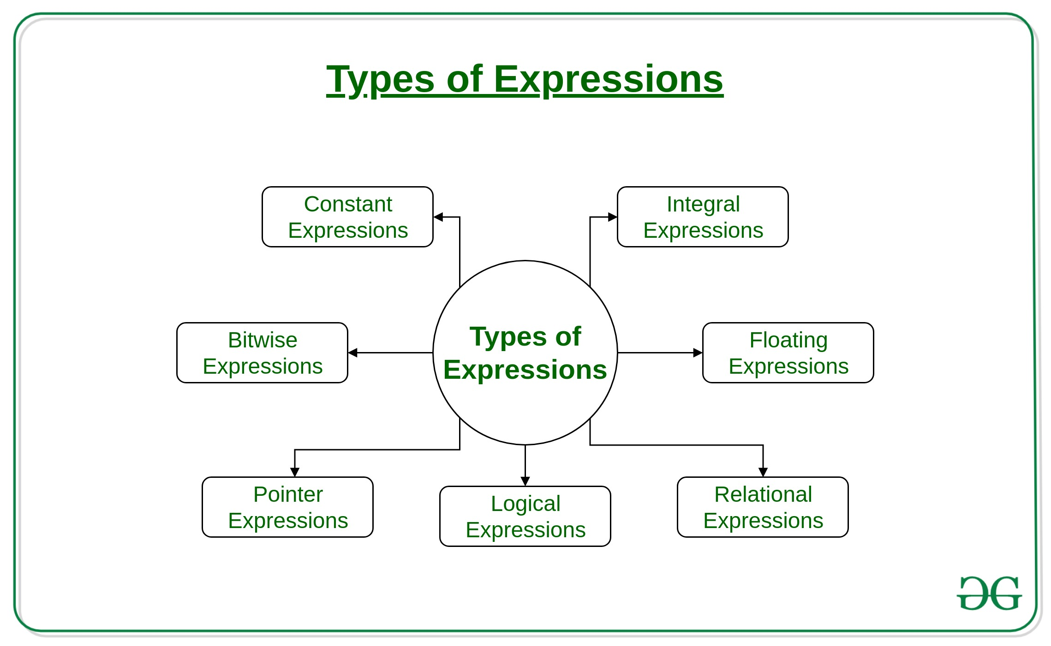

Slide 14
Types of Expressions
1. Constant expressions: Constant Expressions consists of only constant values. A constant value is one that doesn’t change.
Examples:
5, 10 + 5 / 6.0, 'x’
2.Integral expressions: Integral Expressions are those which produce integer results after implementing all the automatic and explicit type conversions.
Examples:
x, x * y, x + int( 5.0)
where x and y are integer variables.
3. Floating expressions: Float Expressions are which produce floating point results after implementing all the automatic and explicit type conversions.
Examples:
x + y, 10.75
where x and y are floating point variables.
4. Relational expressions: Relational Expressions yield results of type bool which takes a value true or false. When arithmetic expressions are used on either side of a relational operator, they will be evaluated first and then the results compared. Relational expressions are also known as Boolean expressions.
Examples:
x <= y, x + y > 2

Slide 15
Logical expressions: Logical Expressions combine two or more relational expressions and produces bool type results. Examples: x > y && x == 10, x == 10 || y == 5
Pointer expressions: Pointer Expressions produce address values. Examples:&x, ptr, ptr++ where x is a variable and ptr is a pointer.
7. Bitwise expressions: Bitwise Expressions are used to manipulate data at bit level. They are basically used for testing or shifting bits. Examples:x << 3 shifts three bit position to left and y >> 1 shifts one bit position to right.
Shift operators are often used for multiplication and division by powers of two.

Slide 16
Discarded Expressions in C
A discarded-value expression is an expression that is used for its side-effects only. The value calculated from such expression is discarded.
Discarded expressions include the full expression of any expression statement.
E.g. x=y; /* b= a= x=y;
The left-hand operand of the built-in comma operator.
e.g. x = (4+3, i++, 5, 9-3);
The operand of a cast-expression that casts to the type void.
E.g. int (4.5+23*2.0)

Slide 17
Constant Expressions
A constant expression is evaluated at compile time, not run time,
Constant Expressions can be used in any place that a constant can be used.
The constant expression must evaluate to a constant that is in the range of
represent-able values for that type
Applications of Constant Expressions
1. Array declaration's size specification
2. Labels of switch statement

Slide 18
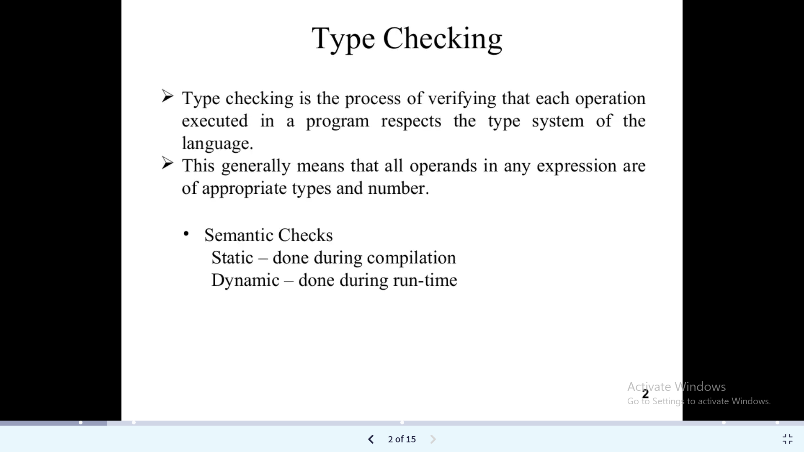
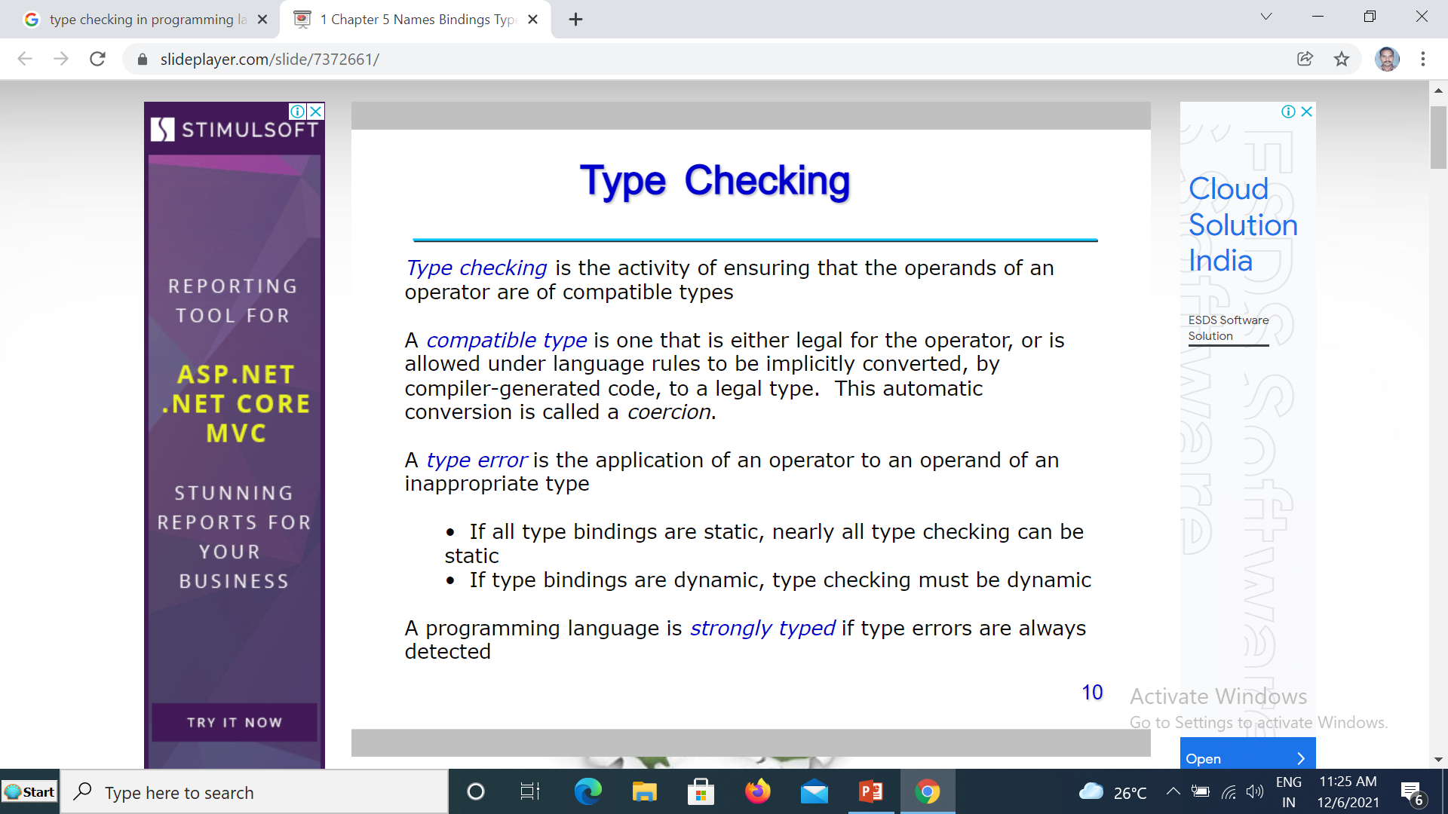

Slide 19
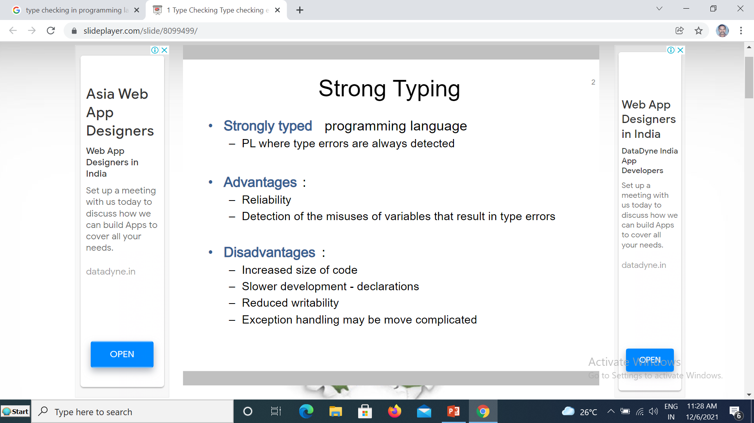
C is often called "weakly typed", which is ill-defined and usually used for bashing a language,
but at least tells that types aren't that important. Type Checking is NOT performed for all Places

Slide 20
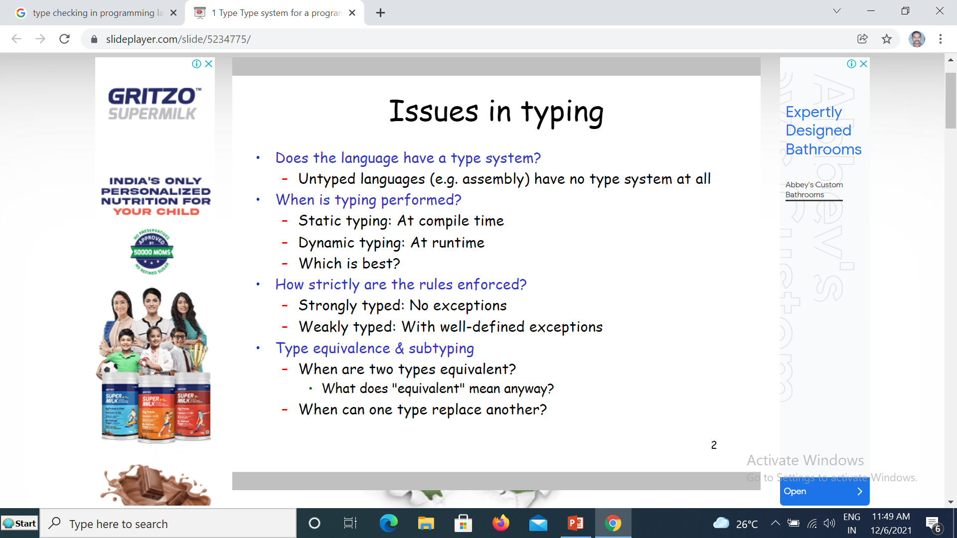
Print Error Messages or Do Type Conversion

Slide 21
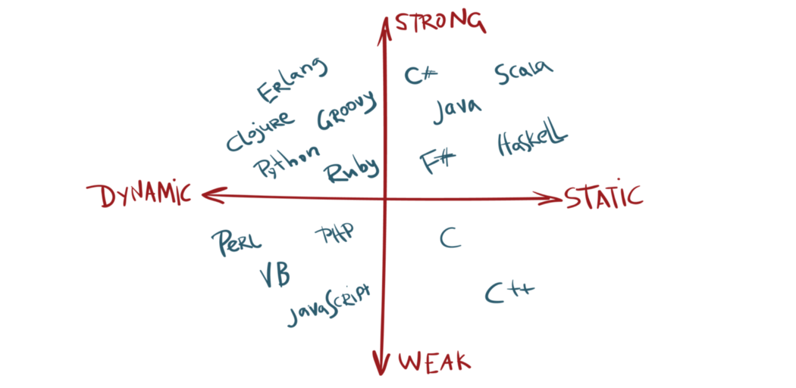

Slide 22
Type Conversion
Converting the type of an expression from one type to another type.
Eg: x = (int)10.45
Division operator on Different Data Type
Operation | Result | Example
int/int | int | 5/2 = 2
int/real | real | 5/2.0 = 2.5
real/int | real | 5.0/2 = 2.5
real/real | real | 5.0/2.0 = 2.5

Slide 23
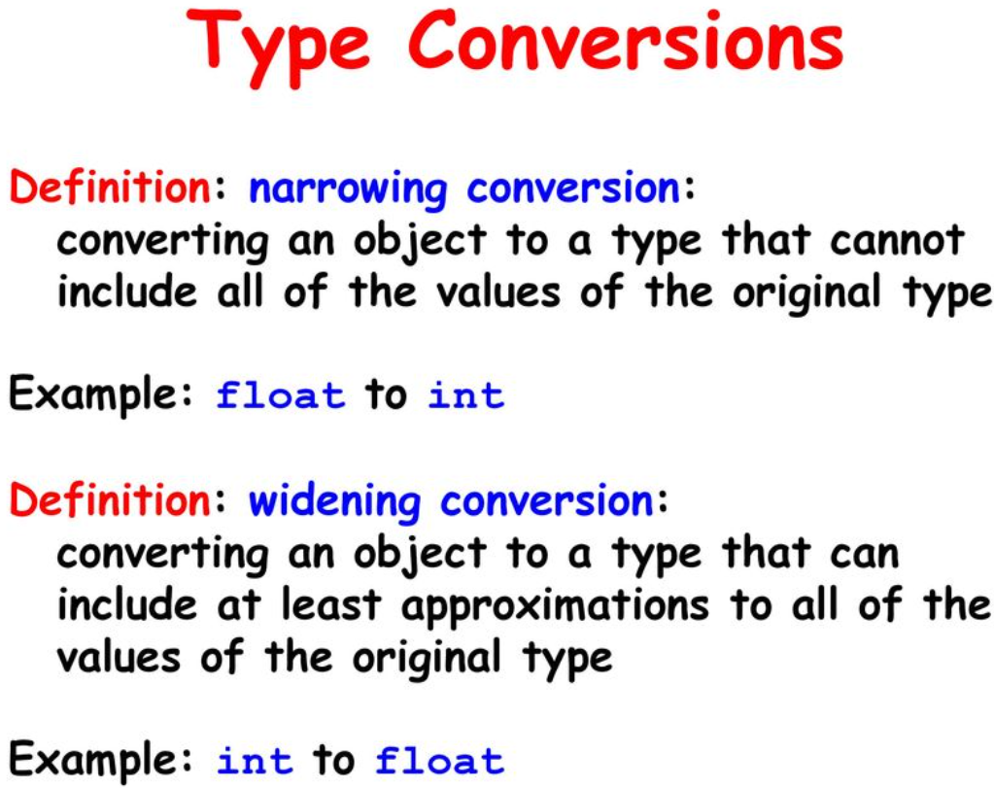
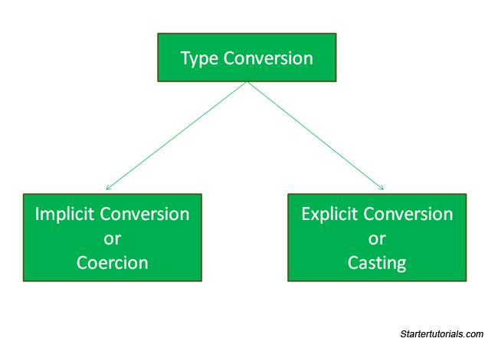

Slide 24
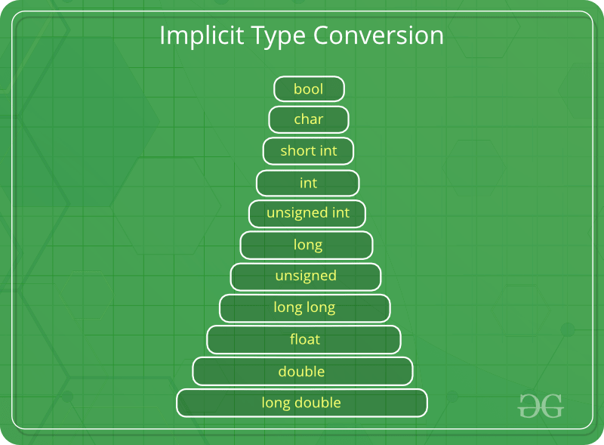
Implicit Type Conversion or coercion
Also known as ‘automatic type conversion’.
Done by the compiler on its own, without any external trigger from the user.
Generally takes place when in an expression more than one data type is present. In such condition type conversion (type promotion) takes place to avoid loss of data.
All the data types of the variables are upgraded to the data type of the variable with largest data type.
It is possible for implicit conversions to lose information, signs can be lost (when signed is implicitly converted to unsigned), and overflow can occur (when long long is implicitly converted to float).

Slide 25
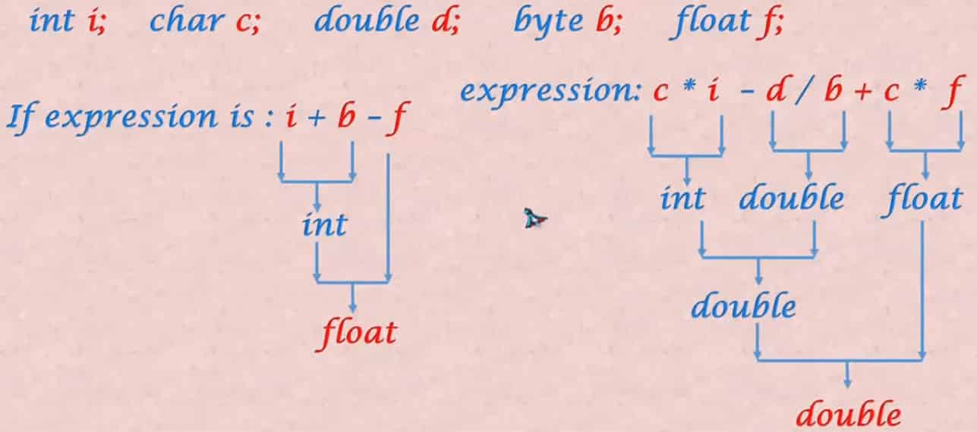

Slide 26
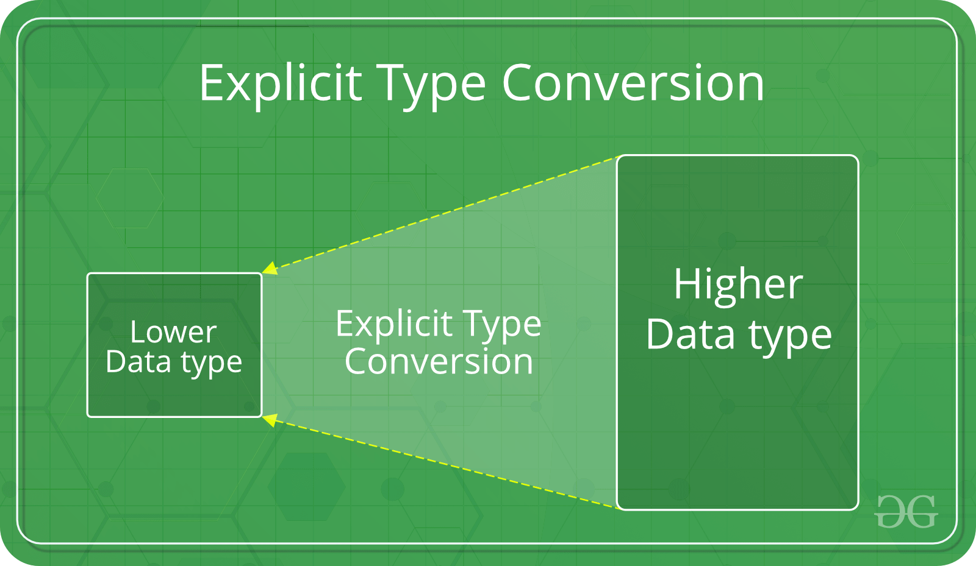
Explicit Type Conversion or Casting
This process is also called type casting and it is user defined. Here the user can type cast the result to make it of a particular data type.
The syntax in C:
(type) expression
Type indicated the data type to which the final result is converted.
Advantages of Type Conversion
This is done to take advantage of certain features of type hierarchies or type representations.
It helps us to compute expressions containing variables of different data types.

Slide 27
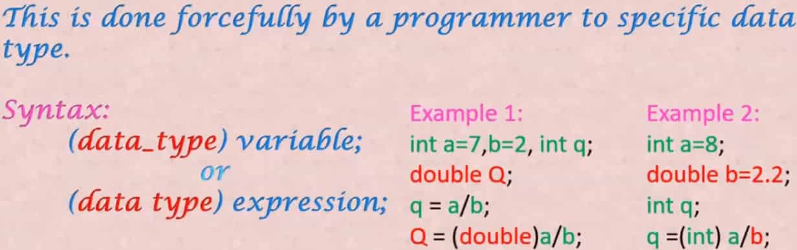

Slide 28
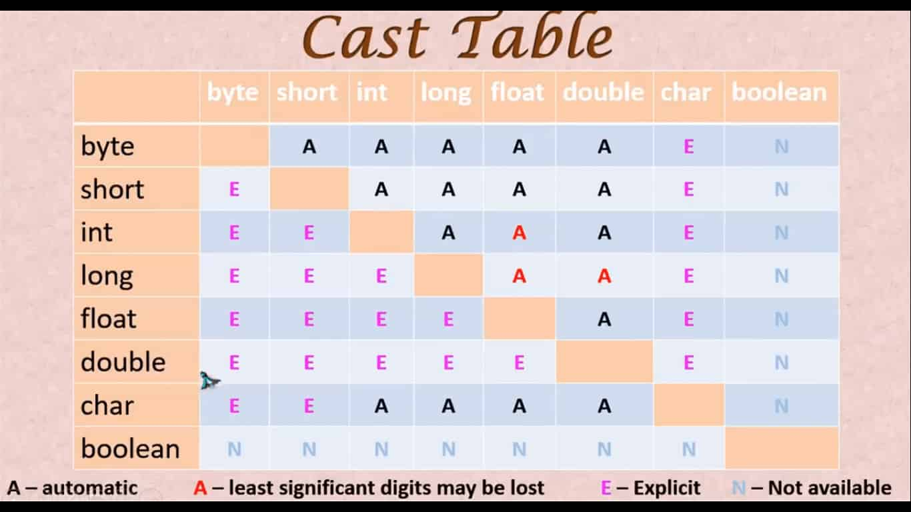

Slide 29
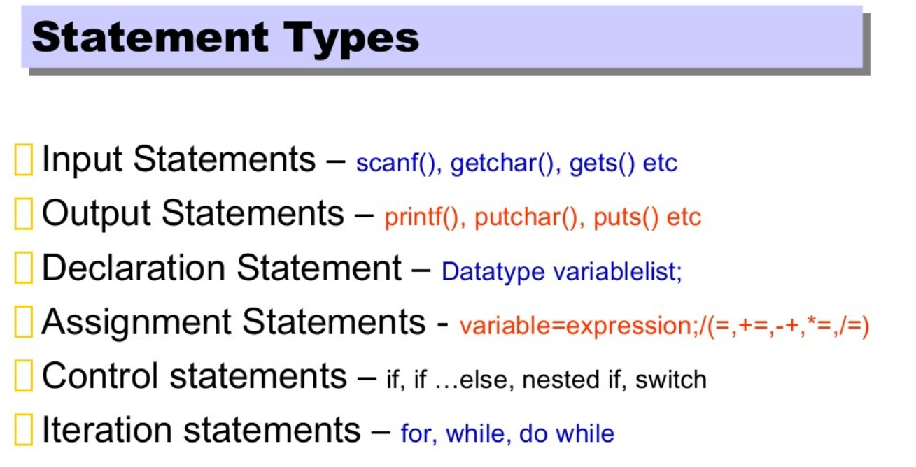
Expression
Statements

Slide 30
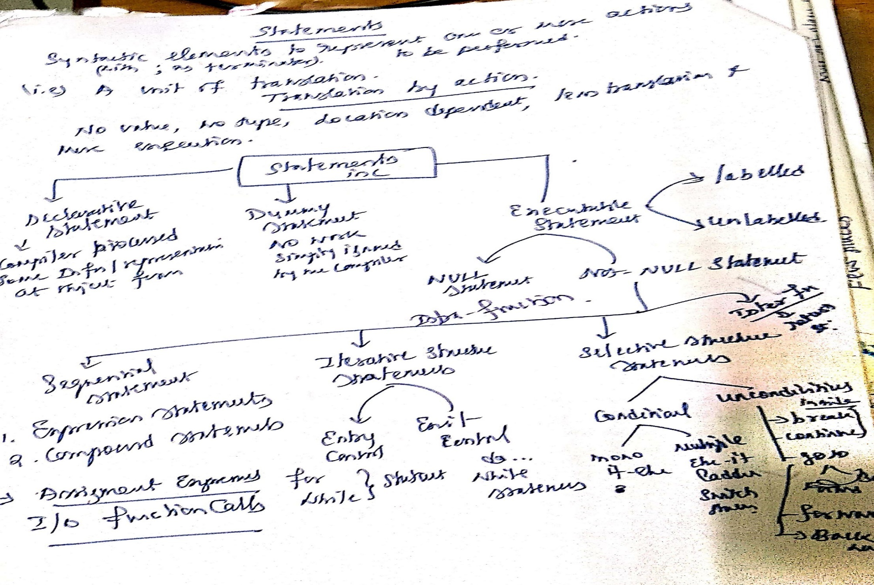
Statements in C

Slide 31
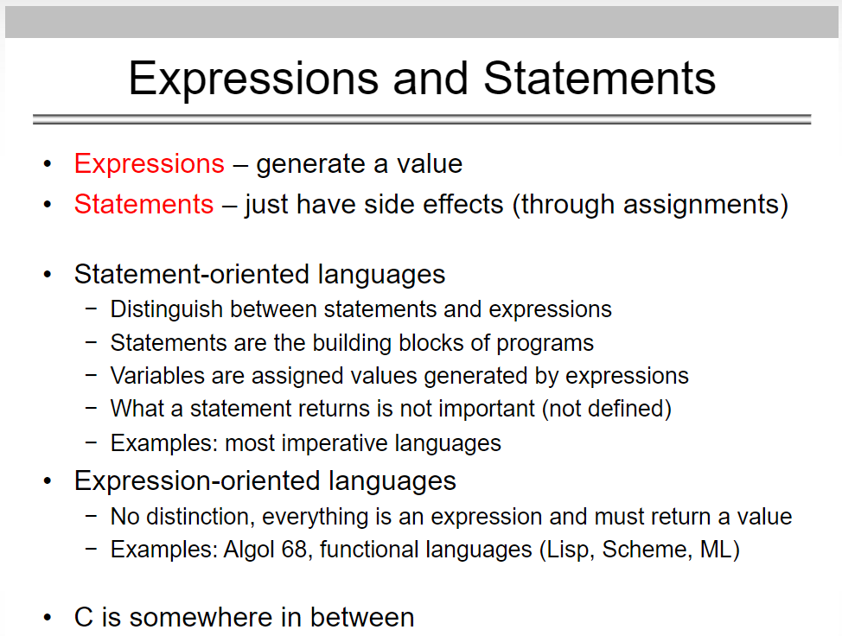

Slide 32
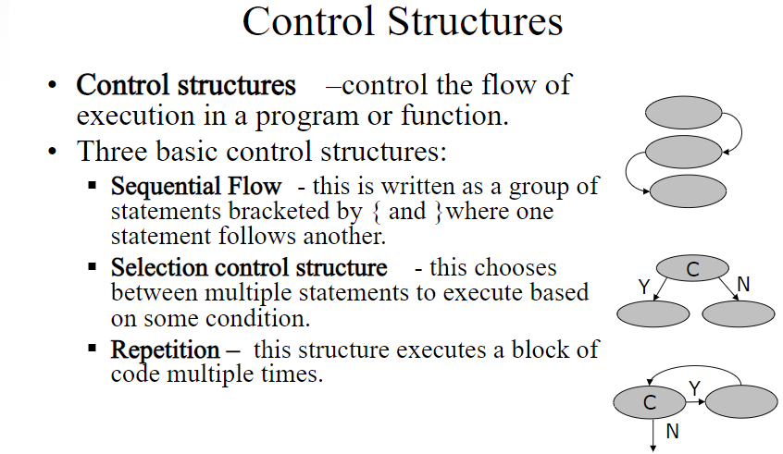

Slide 33
Sequence Control in C program
means flow of execution

Slide 34
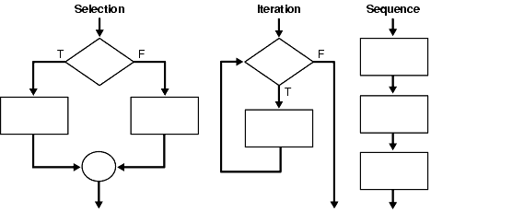

Slide 35
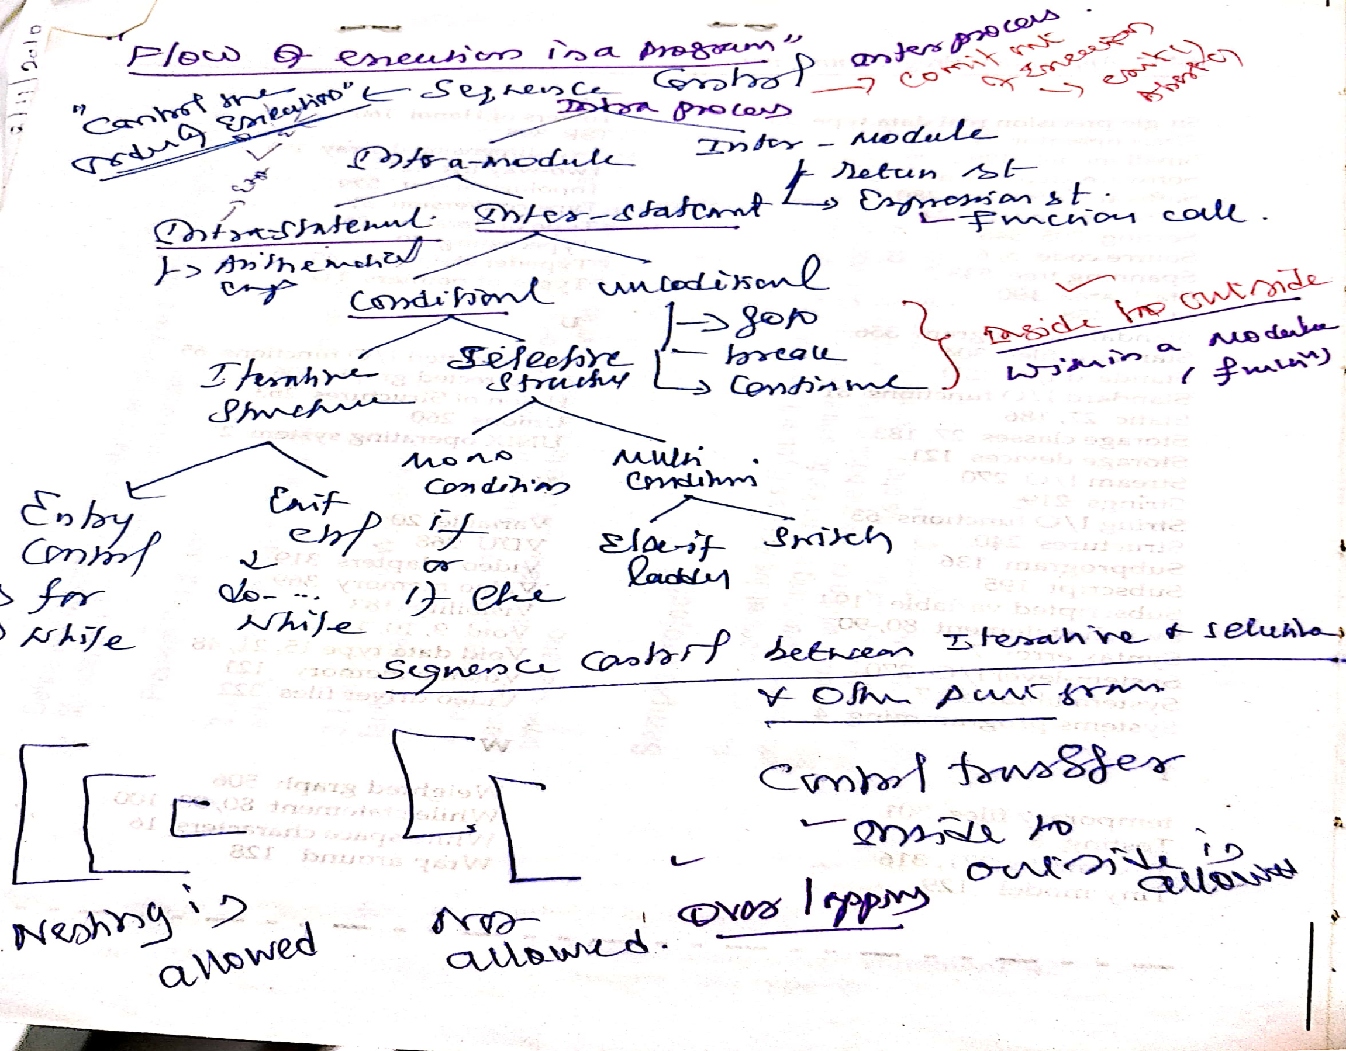

Slide 36
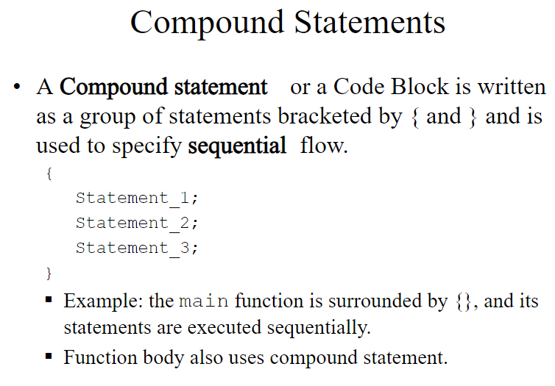

Slide 37
Decision making statements in programming languages decides the direction of flow of program execution. Decision making statements available in C or C++ are:
if statement
if..else statements
nested if statements
if-else-if ladder
switch statements
Jump Statements:
break
continue
goto
return

Slide 38
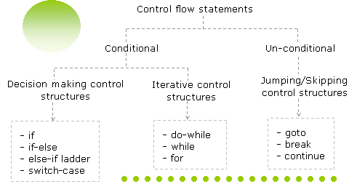

Slide 39
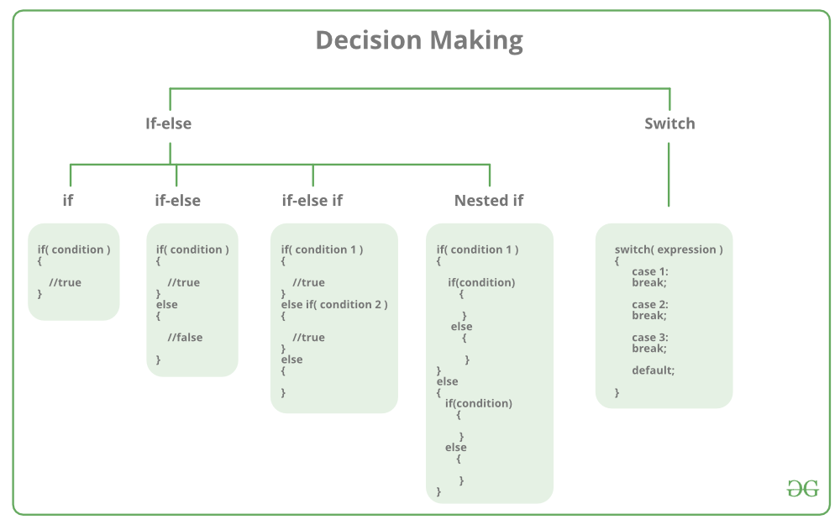

Slide 40
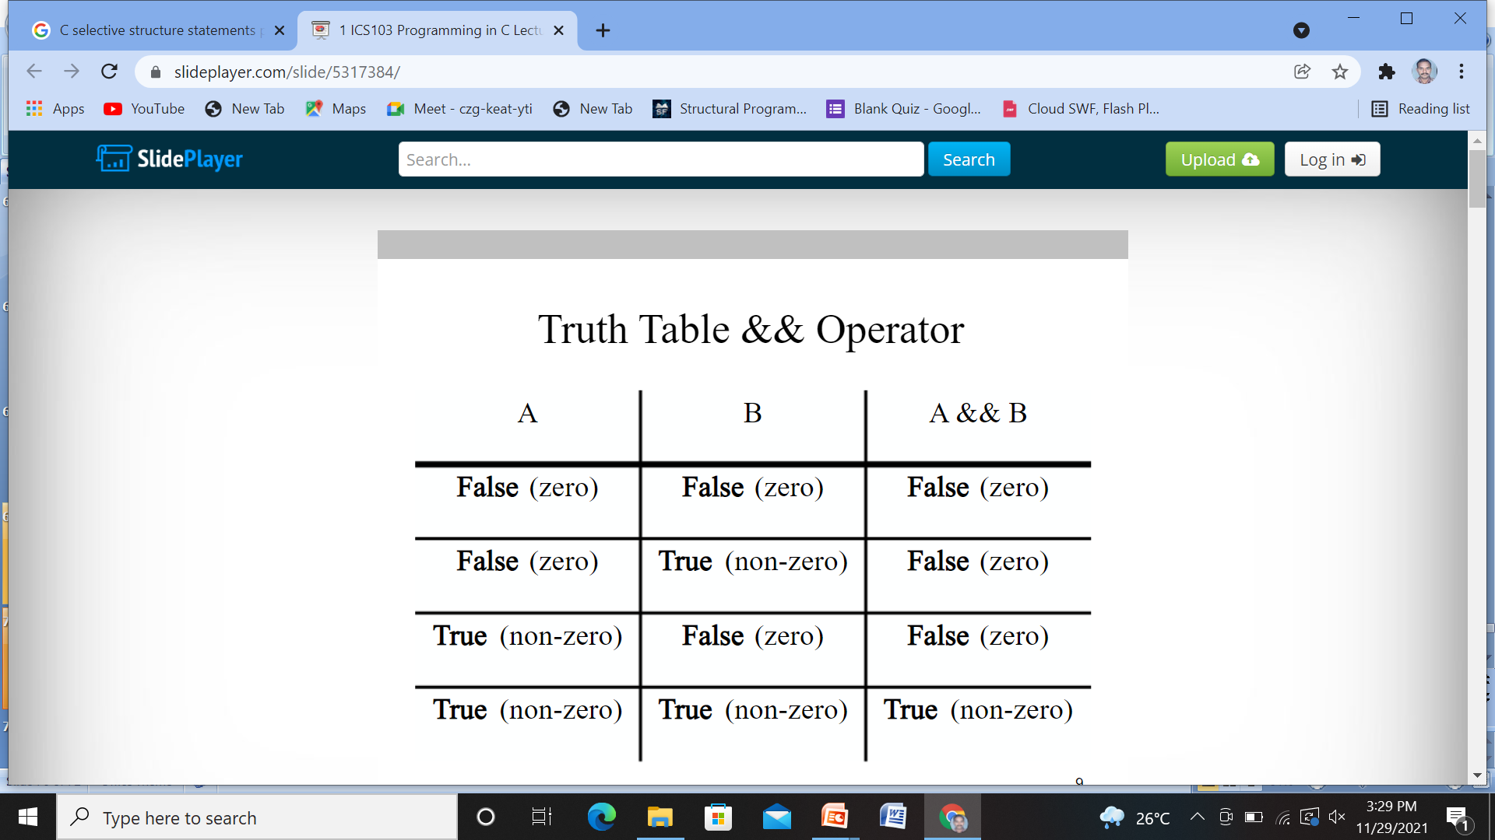

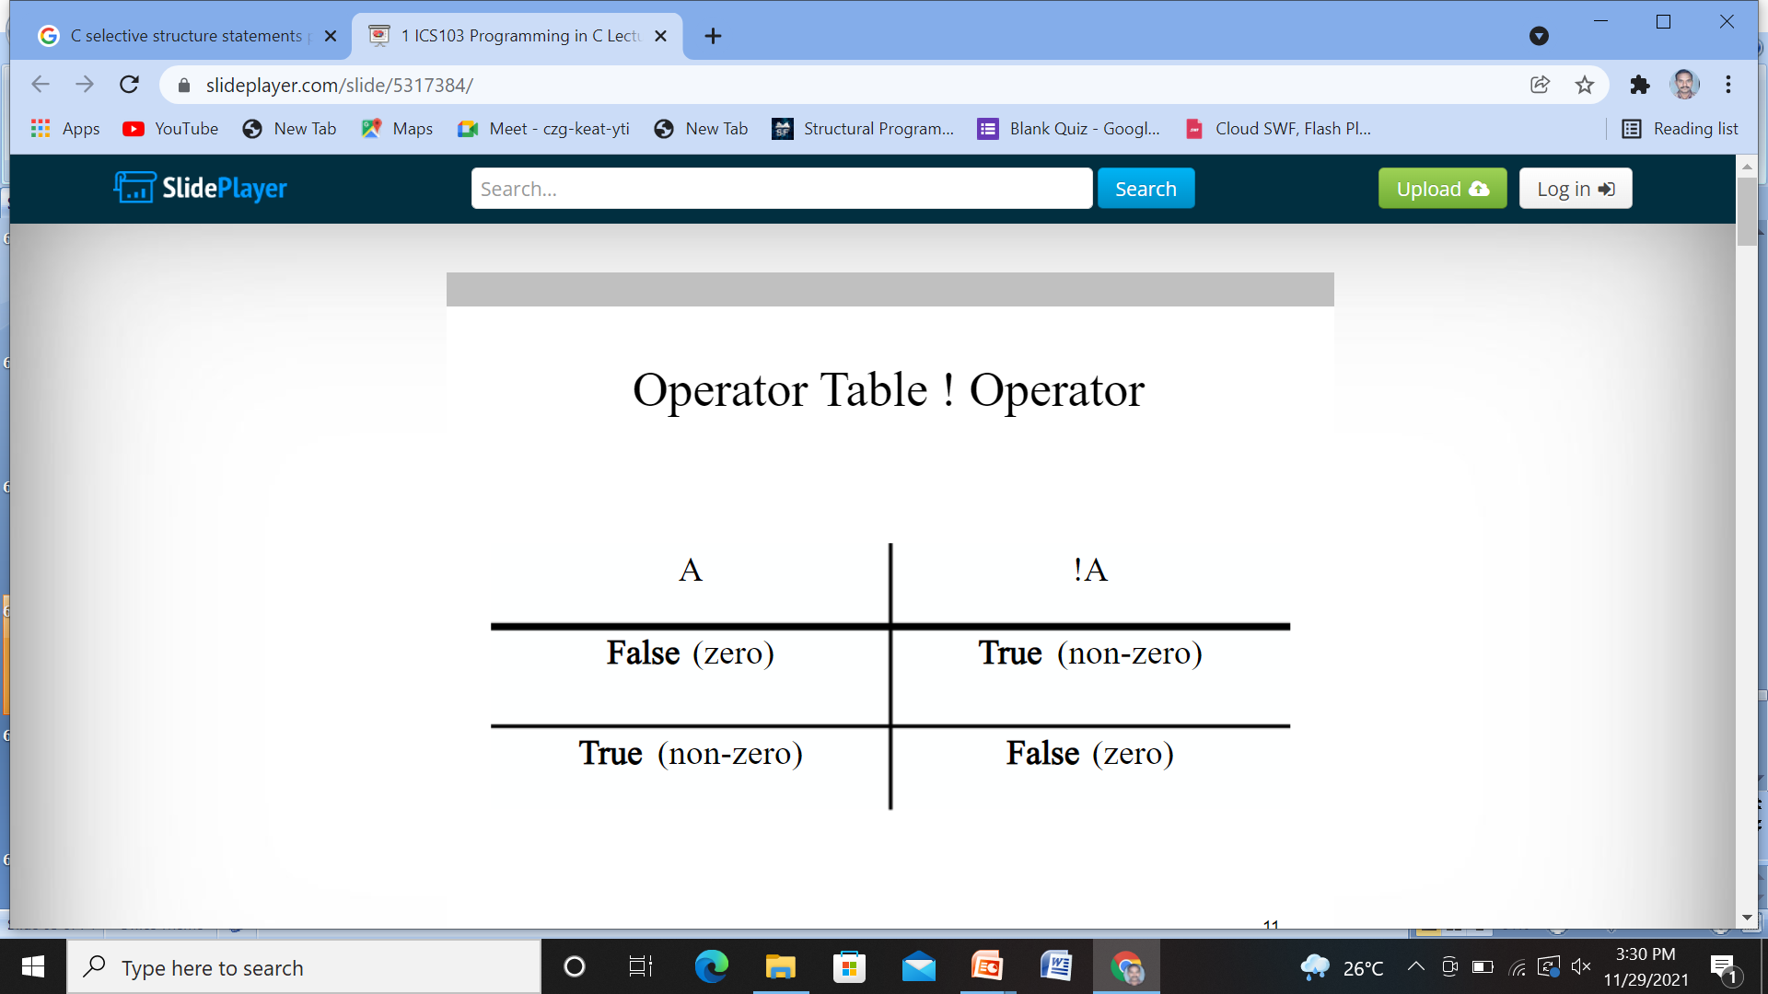

Slide 41
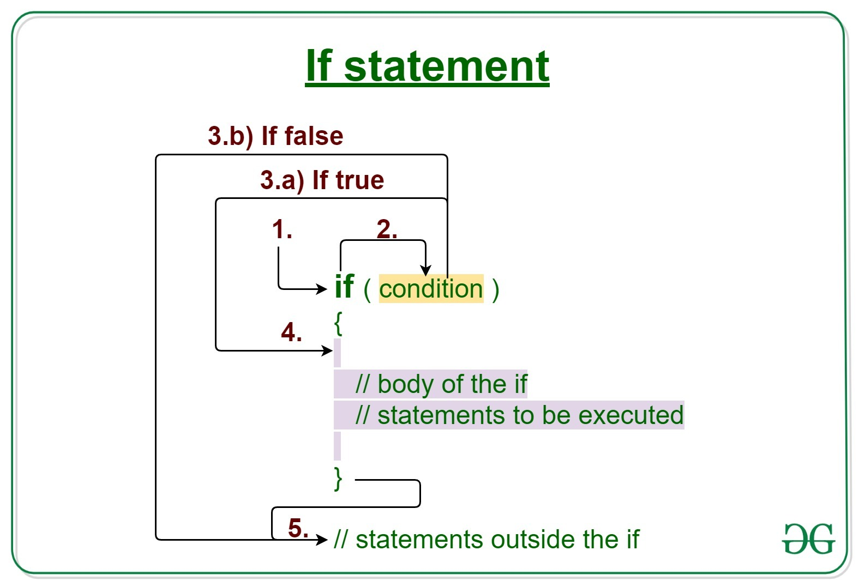
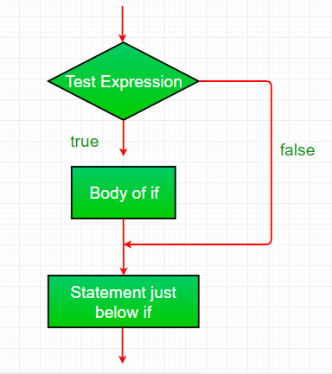

Slide 42
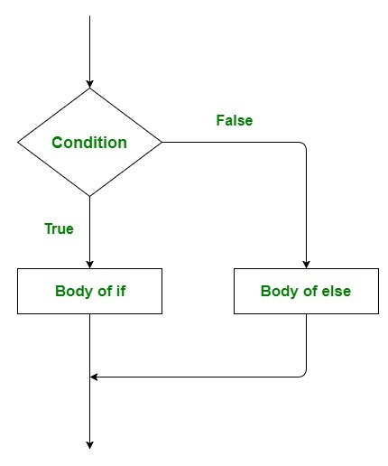
Syntax:
if (condition)
{
// Executes this block if condition is true
}
else
{
// Executes this block if condition is false }

Slide 43
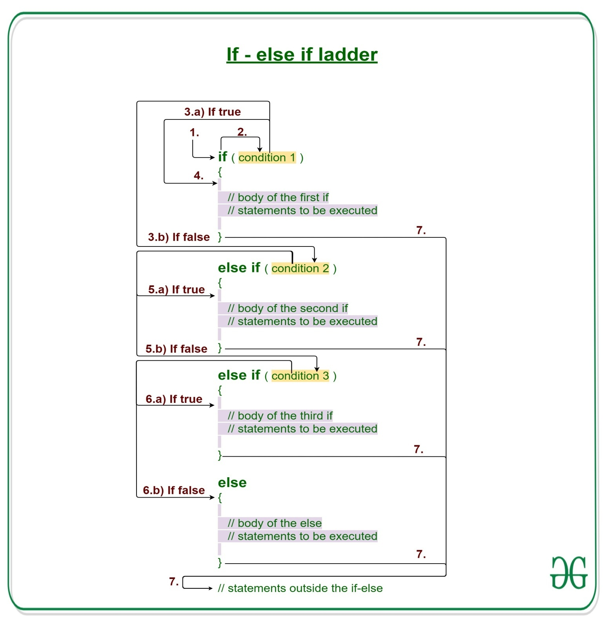
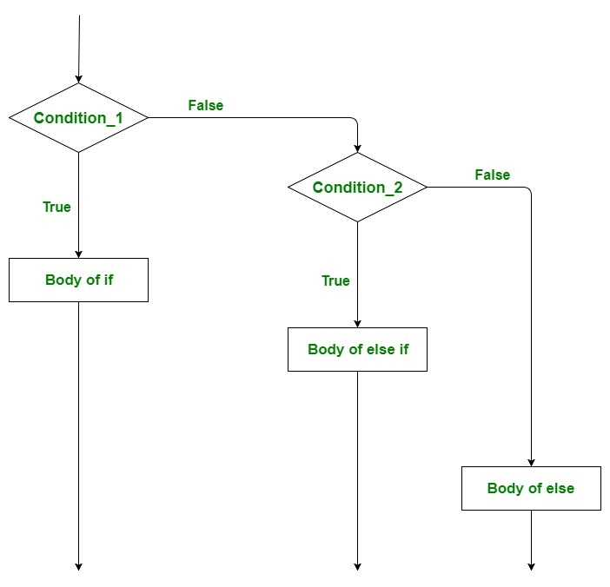

Slide 44
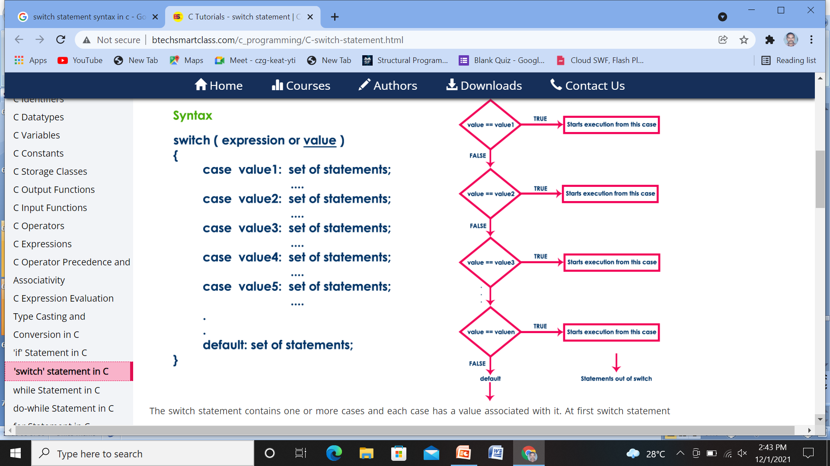

Slide 45
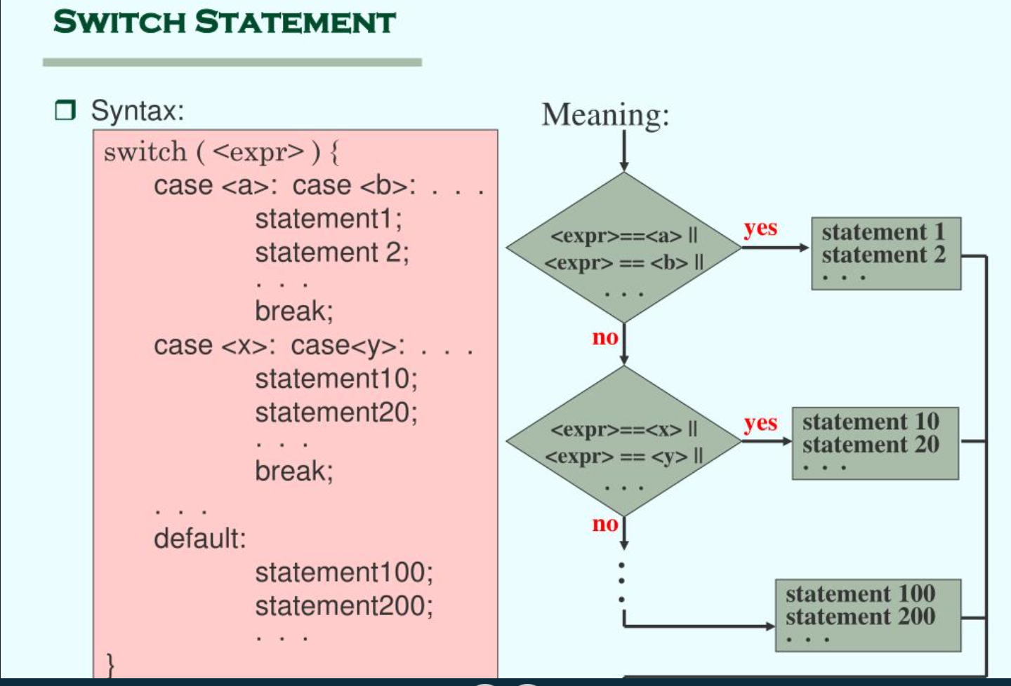

Slide 46
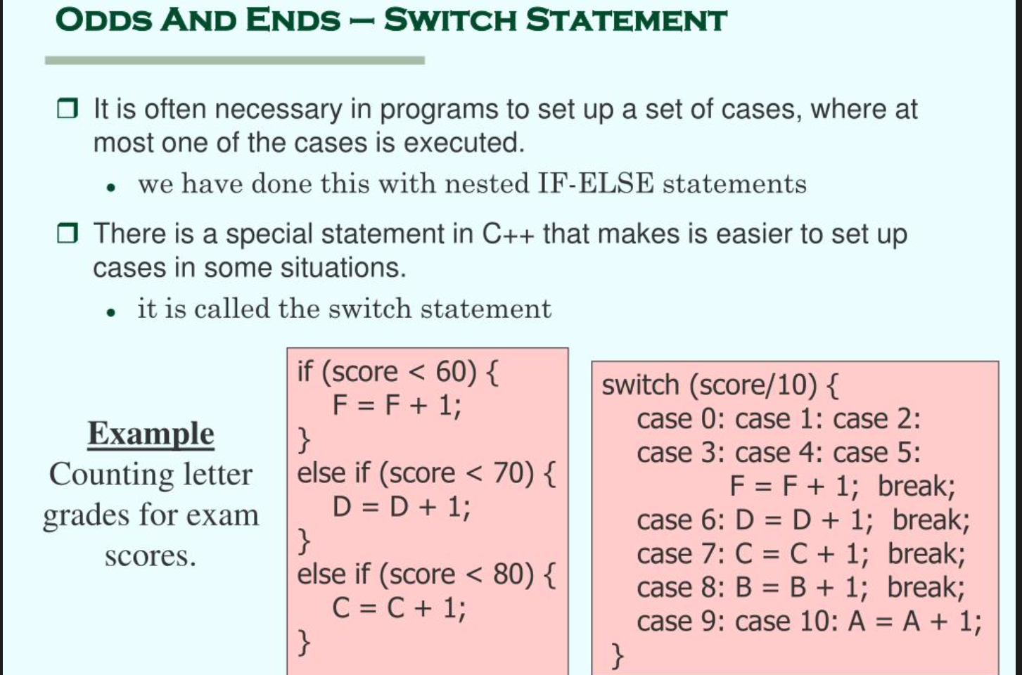

Slide 47
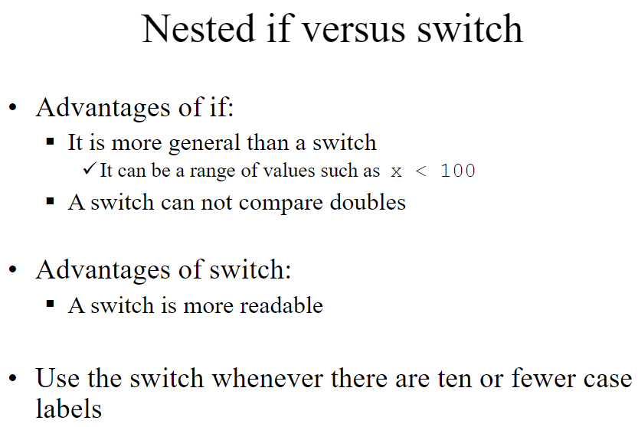

Slide 48
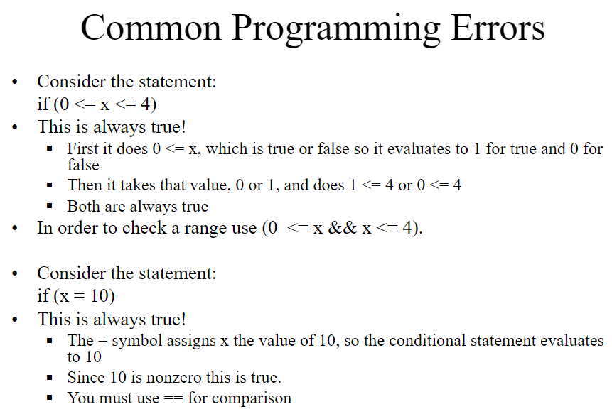

Slide 49
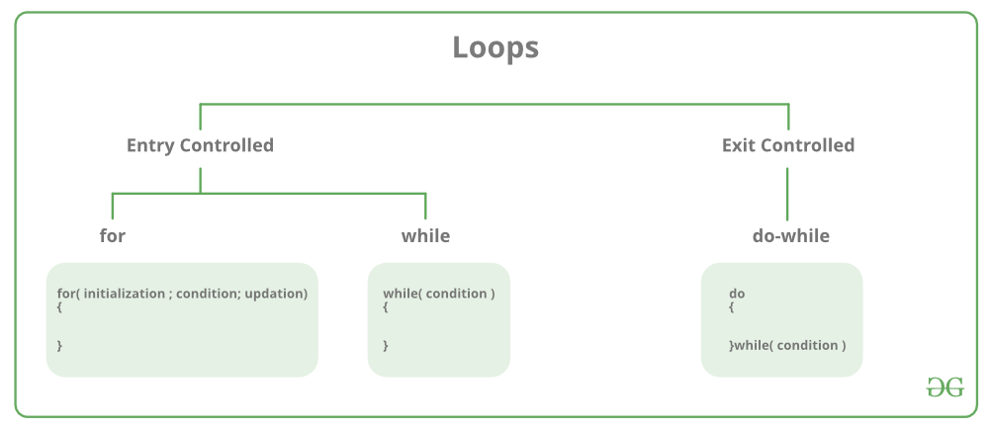

Slide 50
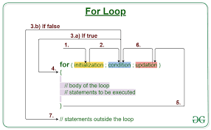

Slide 51
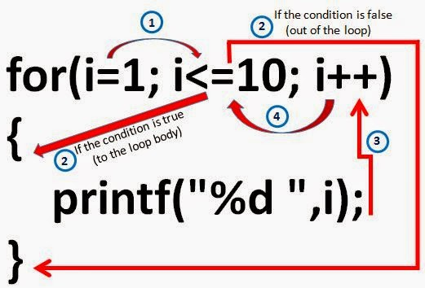

Slide 52
// An Unsigned char example
#include <stdio.h>
int main()
{
unsigned char i;
for (i = 0; i < 256; i++)
printf(“%d \n”,i );
return 0;
}
Output:
Infinite Loop

Slide 53
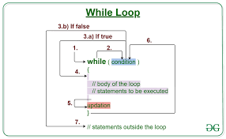

Slide 54
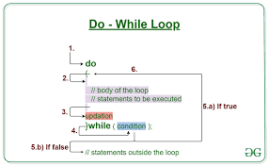

Slide 55
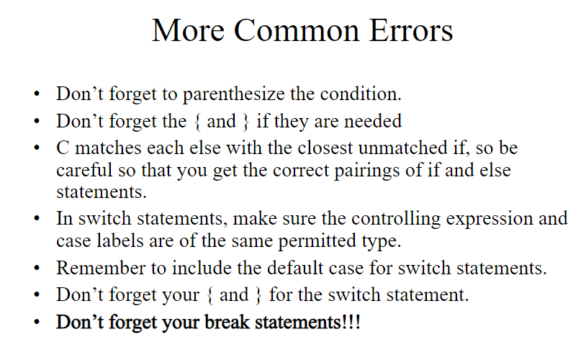

Slide 56
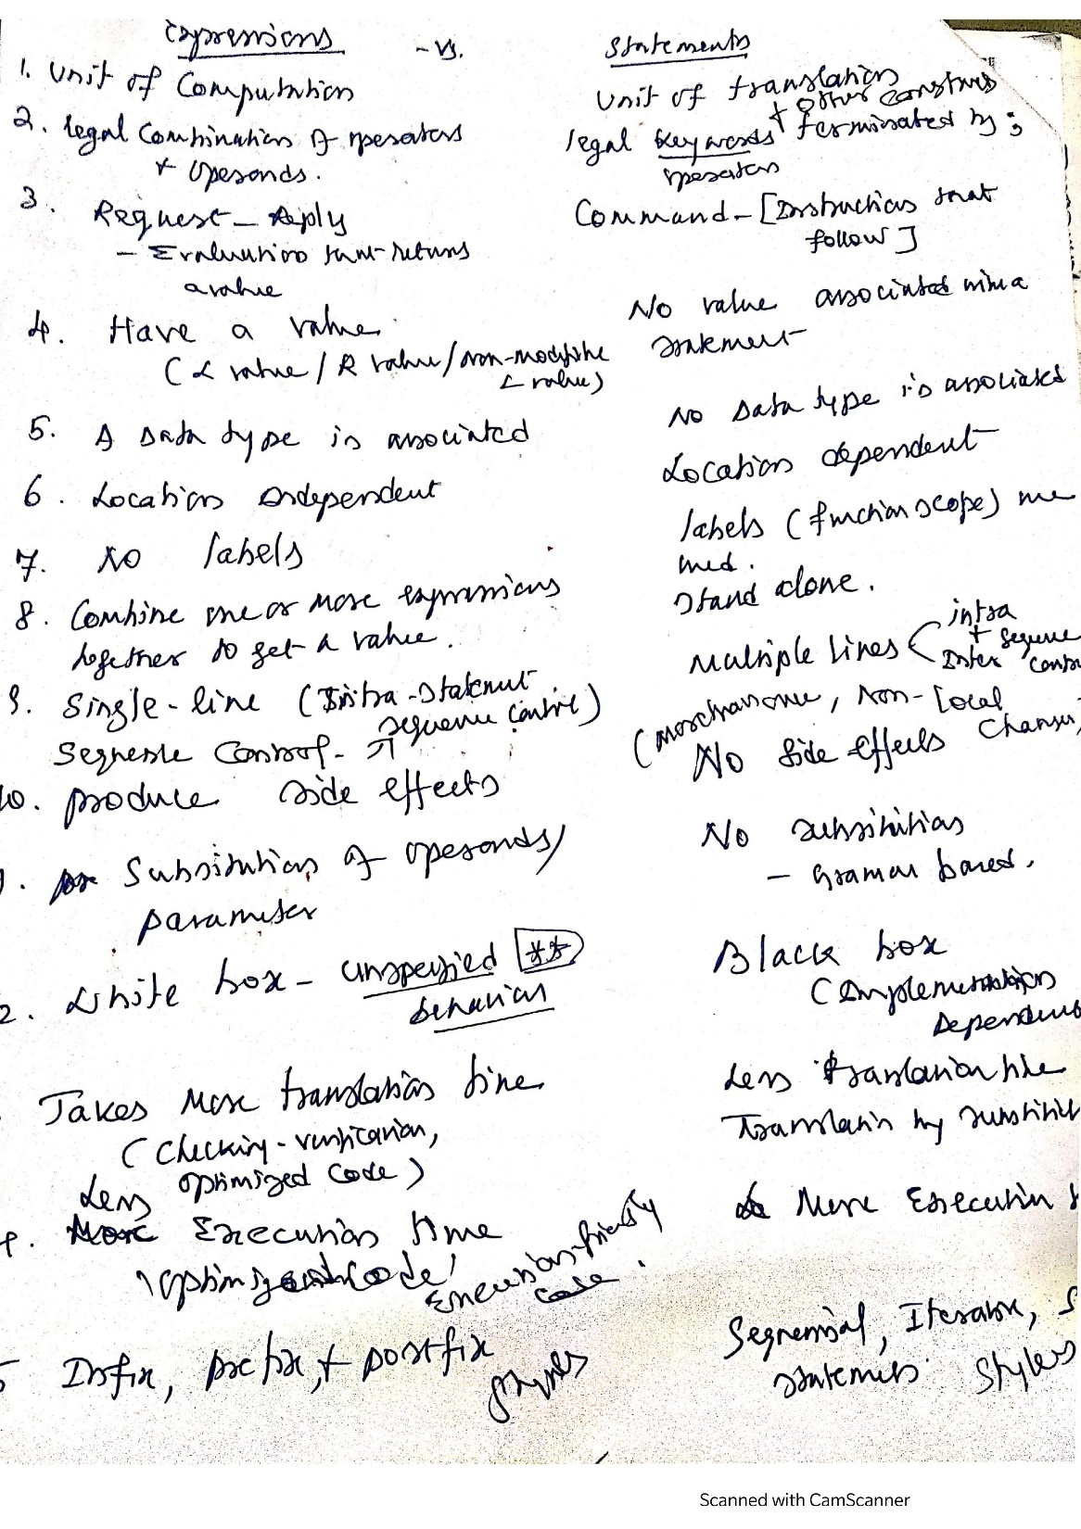

Slide 57
Input Output Management
PRINTF(), SCANF()
CONVERSION SPECIFIERS
ESCAPE SEQUENCES

Slide 58
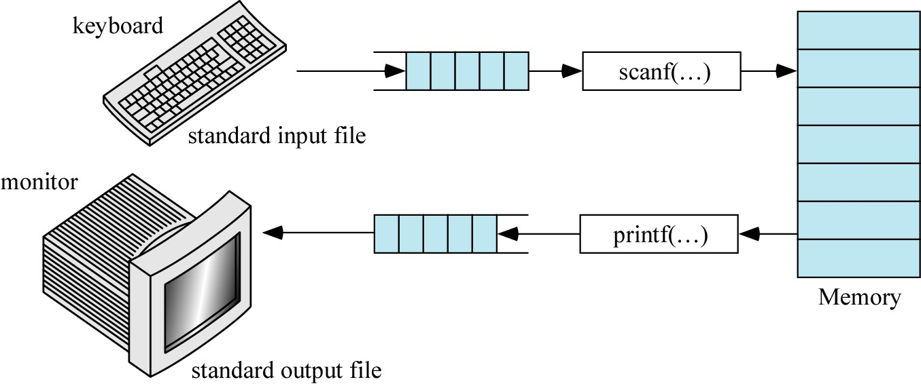
INPUT and OUTPUT

Slide 59
Expression Statements
One form of a expression statement in C :
function(argument list) ;
One example is Scanf function accepts input from standard input device, usually a keyboard
scanf("format string", &var1, &var2, ...);
where “format string” is the string of conversion
specifiers for the various data types in the variable list.
%i. %d
%f
%lf
%Lf
%c
decimal integer (d=decimal)
float
double(where lf="long float")
long double
character
The number of conversion specifiers should match the
number of variables that follow the “format string”.

Slide 60
Keyboard input: scanf()
scanf() will scan formatted input from the keyboard.
It uses the same format specifiers as printf()
To read an integer:
int num_students;
scanf("%d", &num_students);
Specifier for
“reading an integer value”
VERY IMPORTANT
special symbol
“Place value into this
variable”

Slide 61
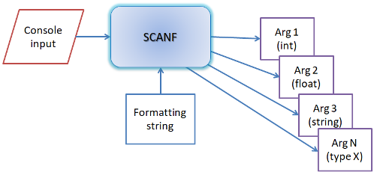
Scanf() working principles
scanf or scan function in C takes a formatting string as input and couple of optional variables as output reference arguments. It converts the scanned string to variables and copies to the output variables.
Format Specifiers
White Spaces
Character expected as input
Scanf is reverse process of printf. Scanf reads console input string.
It iterates each characters of user provided string and stops at "%".
Now scanf reads a line from stdin. User's input comes as a string.
It converts string to char, int, long, float, double and sets the value of the pointer located at the argument.
In care of string it simply copies the string to the output

Slide 62


Slide 63


Slide 64


Slide 65

Escape Sequences

Slide 66
Basic Output function
Printf function
sends output to standard output device,
usually a video monitor
printf("format string", output-list);
where ”format string” can contain characters to be output and the conversion specifiers indicating type and position of the output values. For output, we specify formats conversion specifiers) a little differently than we do for input. For example:
%i, | %d | -decimal integer
%o |  | -octal integer
%x, | %X | -hex integer (use X for caps A - F)
%f |  | -float, double
%c
%s
-character
-character string
www.cyberlabzone.com

Slide 67
Output Control: Special characters
Each is represented by an escape sequence, which is a backslash (\) and an escape character. Examples are:
\" | - | output double quotes
\b | – | backspace
\? | - | output question-mark character | (?)
\\ | - | output backslash character (\)
\n | - | new line
www.cyberlabzone.com

Slide 68
Output Control: Field Width
The number of print positions to be used in the output of display values. For floating-point numbers, we can also specify the number of digits to be displayed after the decimal point.
Examples:
%3d - display an integer using 3 print positions.
%7.3f - display a floating-point number (float, or double) using a total field width of 7 and with 3 places after the decimal point.
www.cyberlabzone.com

Slide 69
Printing Output: printf()
printf() will print formatted output to the screen.
To print a message:
printf("This is a message\n");
this is a string literal
How do we print the value of a variable?
Answer: Use special format specifiers depending on the type of
the variable

Slide 70

printf() working principles
printf or print function in C takes a formatting string and couple of optional variables as input and outputs strings to console while converting input variables to strings.
Printf and scanf takes multiple arguments and these functions are called variable length arguments function or vararg function.
Take printf for consideration. User supply a string and input argumnets. Printf creates an internal buffer for constructing output string. Now printf iterates through each characters of user string and copies the character to the output string.
Printf only stops at "%". "%" means there is an argument to convert. Arguments are in the form of char, int, long, float, double or string. It converts it to string and appends to output buffer. If the argument is string then it does a string copy. Finally printf may reach at the end of user sting and it copies the entire buffer to the stdout file.
Format Specifiers
White Spaces
Character to be printed

Slide 71


Slide 72
int degreesF = 68;
printf("The temperature is %d degrees.", degreesF);
Specifier for
“print an integer value”
“and the value of that number is read from this variable”
Output:
> The temperature is 68 degrees.

Slide 73
printf(“%d plus %d is equal to %d", a, b, c);
int | a | = | 1;
int | b | = | 2;
int | c | = | 3;
Output:
1 plus 2 is equal to 3

Slide 74


Slide 75


Slide 76
Format specifiers:
%c for single characters
%d for integers
%f for float/double (fractions): 1234.56
%g for float/double (scientific): 1.23456E+3
%s for phrases or ‘strings’

Slide 77
Example:
char a='A'; printf("%c
%d %x %0", a, a, a, a);
Output:
A 65 41 101

Slide 78

Format specifier can be used with modifiers
Example :
%-6d, %5d, %6.2f
Modifier
Description
digit
Allocate minimum width (in characters).
.digit
Number of floating-points
-
left justified
l
Print the data as a long integer.

Slide 79
Output
Statement
printf("|%d|", 987); |  | |987|
printf("|%2d|", 987); |  | |987|
printf("|%8d|", 987); |  | | |  | 987|
printf("|%-8d|", 987); |  | |987 |  | |
printf("|%0.2f|", | 9876.54); | |9876.54|
printf("|%4.2f|", | 9876.54); | |9876.54|
printf("|%3.1f|", | 9876.54); | |9876.5|
printf("|%10.3f|", 9876.54); |  | | | 9876.540|

Slide 80
printf(“Hello \n World!");
‘\n’ is not a data to be printed. Instead, it is a command that tells the monitor to move the cursor to the next line
Output:
Hello World!

Slide 81

Control Characters (Escape Sequences)
Character | Description
'\n' | newline
'\t' | horizontal tab
'\v' | vertical tab
'\r' | carriage return
'\x41' | hexadecimal number, 0x41
'\101' | octal number 101
'\0' | null character - indicates the end of a string
'\'' | single quatation mark (')
'\"' | double quatation mark (")
'\\' | backslash mark (\)
'\b' | backspace
'\f' | formfeed - next page (used for printer)
'\a' | alert - produce a beep sound

Slide 82

Figure: Output specification for inventory report
printf (“Part Number\tQty On Hand\tQty On Order\t\tPrice\n”);
\t
\t
\t\t
\n

Slide 83
scanf function | Printf function
Formatted input function | Formatted output function
Deals with ‘stdin’ file | Deals with “stdout’ file
Second arguments onwards address | Second arguments onwards values
It returns an integer to represent the no. of values read and stored at specified locations | It returns an integer to represent the no. of character displayed .
It returns EOF for its failure | It returns EOF for its failure
Non-White space Characters in the Control string are expected at the input | Non-White space Characters in the Control string are printed at the input
No Such facility | Flags are used in the control string
Scan set facility is available [ allowable Characters ] and [^ prevented Characters] | No such Facility
‘* ‘ at the width place skip that value | ‘*.*’ is used to specify the runtime specification
GET, CONVERT and STORE the values | GET, CONVERT AND DISPLAY the values.
Differences

Slide 84
Similarities between scanf() and printf() functions
Both are declared in stdio.h header file
Both are functions with variable no. of arguments(Variadic functions)
Both performed formatted operations
Both are Control string controlled functions
Both returns ‘EOF’ on fail to complete the operation
Scanf function failed due to
Control string is Exhausted.
End of File is encounter.
Scan set character violations
Printf function failed due to
Control string is Exhausted
End of File is encounter
Format specifier format
% flags width prcison size modifier Conversion character
E.g.: %- 10.3 l d

Slide 85
Plan for following Classes
Overview on Arrays
Review of Expressions
Review of Statements
Review of scanf() and printf()
Introduction to Programming languages
Properties of Good and Popular Programming Languages
Classification of Programming languages
PDLC / SDLC
Programming Language environment
Development Environment
Runtime Environment

